Slide 1
ICT407: IT Governance in Organisations
Lecture and Tutorial Week 3:
Dr. Farshid Keivanian

Slide 2
What is Effective IT Governance?
Effective IT governance refers to a systematic framework that ensures the alignment of IT strategy with business goals. It involves the establishment of processes, roles, and responsibilities to ensure that IT investments support the organization’s objectives. Effective IT governance optimizes resource use, mitigates risks, ensures regulatory compliance, and enhances the value delivered by IT projects.

Slide 3
Why is IT governance critical for organizational success in the digital age?
In the digital age, effective IT governance is vital for organizational success due to several key reasons:
1. Alignment of IT with Business Goals:
Example: Commonwealth Bank of Australia (CBA)
Details: CBA utilizes IT governance to align its IT investments with its strategic objectives, such as enhancing customer experience through digital banking platforms. By ensuring IT projects support business goals like improving online services and mobile banking, CBA maximizes the value of its IT investments.

Slide 4
Why is IT governance critical for organizational success in the digital age?
2. Risk Management:
Example: Telstra
Details: Telstra, a leading telecommunications company, implements IT governance to manage risks associated with cybersecurity and data privacy. By establishing robust IT risk management frameworks, Telstra can protect its network infrastructure and customer data from cyber threats, ensuring reliable and secure communication services.

Slide 5
Why is IT governance critical for organizational success in the digital age?
3. Resource Optimization:
Example: BHP
Details: BHP, a global resources company, uses IT governance to optimize its IT resources, including hardware, software, and personnel. By prioritizing IT projects that align with business priorities, BHP ensures efficient allocation of resources, reducing costs and improving operational efficiency in its mining operations.

Slide 6
Why is IT governance critical for organizational success in the digital age?
4. Performance Measurement:
Example: Woolworths Group
Details: Woolworths Group, a major Australian retailer, employs IT governance to measure the performance of its IT initiatives. By tracking key performance indicators (KPIs) such as system uptime and transaction processing speed, Woolworths can continuously improve its IT services, enhancing the overall shopping experience for customers.

Slide 7
Why is IT governance critical for organizational success in the digital age?
5. Compliance and Legal Requirements:
Example: ANZ
Details: ANZ, a multinational banking and financial services company, leverages IT governance to ensure compliance with regulatory requirements such as data protection and privacy laws. IT governance frameworks help ANZ maintain compliance with regulations like the Australian Prudential Regulation Authority (APRA) standards, minimizing legal risks and protecting its reputation.

Slide 8
Why is IT governance critical for organizational success in the digital age?
6. Innovation and Competitive Advantage:
Example: Qantas
Details: Qantas, Australia's largest airline, uses IT governance to foster innovation and maintain a competitive edge. By investing in advanced IT solutions like artificial intelligence for predictive maintenance and customer service chatbots, Qantas enhances operational efficiency and improves passenger experiences, staying ahead in the competitive airline industry.

Slide 9
Why is IT governance critical for organizational success in the digital age?
In summary, IT governance is critical for organizational success in the digital age as it ensures alignment with business goals, manages risks, optimizes resources, measures performance, ensures compliance, and fosters innovation. Organizations like Commonwealth Bank of Australia, Telstra, BHP, Woolworths Group, ANZ, and Qantas benefit significantly from robust IT governance frameworks, driving their growth and success in the digital era.

Slide 10
How does the COBIT framework support organizations in meeting regulatory compliance and managing risks?
Australian financial institutions like ANZ Bank use the COBIT framework to ensure compliance with financial regulations and mitigate operational risks.

Slide 11
How does the COBIT framework support organizations in meeting regulatory compliance and managing risks?
Explanation:
1. Regulatory Compliance:
ANZ Bank applies the COBIT framework to align its IT processes with regulatory requirements set by entities such as the Australian Prudential Regulation Authority (APRA) and the Australian Securities and Investments Commission (ASIC). COBIT provides a comprehensive set of control objectives and best practices that help ANZ Bank maintain compliance with stringent financial regulations, including data protection laws and reporting standards.

Slide 12
How does the COBIT framework support organizations in meeting regulatory compliance and managing risks?
Explanation:
2. Risk Management:
By implementing COBIT, ANZ Bank can effectively identify, assess, and manage IT-related risks. The framework offers a structured approach to risk management, ensuring that all potential IT risks, such as cyber threats, data breaches, and system failures, are addressed proactively. COBIT’s risk management guidelines help ANZ Bank in developing robust risk mitigation strategies, thus safeguarding its operations and customer data.

Slide 13
How does the COBIT framework support organizations in meeting regulatory compliance and managing risks?
Explanation:
3. Improved Governance:
ANZ Bank uses COBIT to enhance its IT governance structure, ensuring that IT initiatives align with the bank’s strategic objectives. This alignment ensures that IT investments deliver value and support business goals, such as improving customer service through digital banking platforms and enhancing operational efficiency.

Slide 14
How does the COBIT framework support organizations in meeting regulatory compliance and managing risks?
Explanation:
4. Performance Measurement:
The COBIT framework enables ANZ Bank to establish key performance indicators (KPIs) and metrics to monitor and evaluate the effectiveness of its IT processes. This continuous monitoring helps the bank to identify areas for improvement, ensuring that IT services remain reliable and effective.

Slide 15
How does the COBIT framework support organizations in meeting regulatory compliance and managing risks?
In summary, the COBIT framework supports organizations like ANZ Bank in meeting regulatory compliance and managing risks by providing a structured approach to aligning IT processes with regulatory requirements, enhancing risk management strategies, improving IT governance, and measuring IT performance. This ensures that ANZ Bank operates securely and efficiently in a highly regulated financial environment.

Slide 16
Discussion Question
Can you find an example of a company that uses the COBIT framework for regulatory compliance and risk management? How has the framework benefited the company, and what challenges did they face during implementation?

Slide 17
What are the key benefits and challenges of implementing IT governance frameworks in different regions?
Example:
Adoption of IT governance frameworks in European healthcare organizations
Key Benefits:
Streamlined Operations:
Example: In the United Kingdom, the National Health Service (NHS) has implemented IT governance frameworks like ITIL (Information Technology Infrastructure Library) to streamline its operations. This has led to improved patient care through efficient management of IT services and resources, reducing downtime and ensuring the availability of critical health systems.

Slide 18
What are the key benefits and challenges of implementing IT governance frameworks in different regions?
2. Enhanced Data Security:
Example: In Germany, healthcare organizations adhere to IT governance frameworks to comply with the General Data Protection Regulation (GDPR). This ensures robust data protection measures, safeguarding patient information from breaches and cyber threats.

Slide 19
What are the key benefits and challenges of implementing IT governance frameworks in different regions?
3. Improved Decision-Making:
Example: In France, hospitals have adopted IT governance frameworks to facilitate better decision-making processes. By standardizing IT practices and integrating data from various sources, these organizations can make informed decisions to improve healthcare delivery and resource management.

Slide 20
What are the key benefits and challenges of implementing IT governance frameworks in different regions?
Key Challenges:
1. Cultural and Organizational Resistance:
Example: In Spain, the adoption of IT governance frameworks in healthcare organizations has faced resistance due to established cultural practices and organizational structures. Overcoming this resistance requires effective change management strategies and stakeholder engagement.

Slide 21
What are the key benefits and challenges of implementing IT governance frameworks in different regions?
Key Challenges:
2. Resource Constraints:
Example: Smaller healthcare facilities in Eastern European countries, such as Romania, often struggle with limited financial and human resources to implement comprehensive IT governance frameworks. This can hinder the adoption process and the ability to maintain such frameworks effectively.

Slide 22
What are the key benefits and challenges of implementing IT governance frameworks in different regions?
Key Challenges:
3. Regulatory Compliance:
Example: In Italy, healthcare organizations must navigate complex regulatory requirements when implementing IT governance frameworks. Ensuring compliance with both national and European regulations can be challenging and requires significant effort and expertise.

Slide 23
What are the key benefits and challenges of implementing IT governance frameworks in different regions?
In summary, the adoption of IT governance frameworks in European healthcare organizations provides significant benefits such as streamlined operations, enhanced data security, and improved decision-making. However, challenges such as cultural resistance, resource constraints, and regulatory compliance need to be addressed to fully realize these benefits.

Slide 24
Aligning IT and business strategies enhances organizational performance, can you provide an example of a company that has successfully implemented this alignment?
Aligning IT and business strategies is crucial for enhancing organizational performance because it ensures that IT initiatives directly support and drive business objectives. Here’s how this alignment can enhance performance:
Example:
Telstra’s alignment of IT initiatives with business goals has resulted in innovative service offerings and improved customer satisfaction.

Slide 25
How does aligning IT and business strategies enhance organizational performance?
Explanation:
1. Innovation in Service Offerings:
Example: Telstra, Australia’s largest telecommunications provider, aligns its IT initiatives with business strategies to develop and launch innovative services such as 5G connectivity and IoT solutions. By prioritizing IT projects that support strategic goals, Telstra stays ahead in the competitive telecom market, offering cutting-edge technology and services that meet evolving customer needs.

Slide 26
How does aligning IT and business strategies enhance organizational performance?
2. Improved Customer Satisfaction:
Example: By integrating customer feedback into their IT strategy, Telstra has been able to enhance customer service platforms, such as the My Telstra app, which offers users seamless account management, troubleshooting support, and service customization. This alignment of IT with customer service goals has significantly improved customer satisfaction and loyalty.

Slide 27
How does aligning IT and business strategies enhance organizational performance?
3. Operational Efficiency:
Example: Telstra leverages IT governance to streamline its internal processes, ensuring that IT resources are used efficiently. For instance, by adopting automated network management tools, Telstra can quickly identify and resolve network issues, reducing downtime and maintaining high service quality for customers.

Slide 28
How does aligning IT and business strategies enhance organizational performance?
4. Strategic Planning and Execution:
Example: Telstra’s strategic IT planning involves cross-functional collaboration, ensuring that IT projects support broader business objectives like market expansion and digital transformation. This holistic approach allows Telstra to execute its business strategy effectively, aligning technological advancements with growth opportunities.

Slide 29
How does aligning IT and business strategies enhance organizational performance?
5. Risk Management and Compliance:
Example: Aligning IT and business strategies also helps Telstra in managing risks and ensuring compliance with industry regulations. By embedding regulatory requirements into IT governance frameworks, Telstra mitigates potential legal risks and maintains its reputation as a reliable and compliant service provider.

Slide 30
How does aligning IT and business strategies enhance organizational performance?
In summary, aligning IT and business strategies at Telstra has enhanced organizational performance by driving innovation in service offerings, improving customer satisfaction, increasing operational efficiency, ensuring effective strategic planning, and managing risks and compliance. This alignment has been crucial in maintaining Telstra’s competitive edge and achieving its business objectives.

Slide 31
Overcoming Challenges in Information System Governance
What strategies can organizations adopt to overcome common challenges in IT governance?
Organizations can adopt agile methodologies to address dynamic challenges in IT governance, ensuring flexibility and responsiveness in a fast-paced business environment.
Example: Companies in Melbourne are adopting agile methodologies to address the dynamic challenges of IT governance in a fast-paced business environment.

Slide 32
Overcoming Challenges in Information System Governance
Interactive Class Activity
Could you discuss or research another example of how organizations adopt strategies to overcome IT governance challenges. For instance, you can investigate how Telstra employs DevOps practices to enhance its IT governance framework and improve operational efficiency. You can present you findings and compare them with the Melbourne companies' example, discussing the similarities and differences in the strategies used to address IT governance challenges.

Slide 33
Key Functions and Importance of IT Governance
How do IT governance frameworks translate board-level strategies into operational actions?
IT governance frameworks translate board-level strategies into operational actions by providing structured processes and guidelines that ensure IT initiatives align with and support strategic goals.
Example: The use of IT governance at Woolworths has helped translate strategic goals into effective IT service delivery and process improvements.

Slide 34
Key Functions and Importance of IT Governance
Interactive Class Activity
Could you discuss or research another example of how IT governance frameworks have helped an organization translate strategic goals into operational actions. For instance, you could look into companies like BHP or Telstra and explore how they use IT governance to align their IT initiatives with business objectives. You can present your findings and discuss the similarities and differences with the Woolworths example.

Slide 35
Adopting IT Governance Frameworks, Best Practices, and Standards
What are the best practices for adopting and implementing IT governance frameworks?
Best practices for adopting and implementing IT governance frameworks include aligning IT initiatives with business goals, involving key stakeholders in the decision-making process, and continuously monitoring and improving IT processes.
Example: Brisbane City Council has successfully adopted ITIL best practices to improve its IT service management and governance.

Slide 36
Adopting IT Governance Frameworks, Best Practices, and Standards
Interactive Class Activity
Could you investigate how the Australian Taxation Office (ATO) implements COBIT for IT governance and the benefits it has achieved. Please present your findings and compare them with the Brisbane City Council example, discussing the similarities and differences in the adoption and implementation of IT governance frameworks.

Slide 37
Research Gaps and Challenges in IT Governance
Why is academic research on IT governance still limited, and how can organizations benefit from professional guidelines?
Academic research on IT governance is still limited due to the rapidly evolving nature of technology and the complexity of IT governance frameworks. However, organizations can benefit from professional guidelines by leveraging established best practices to improve their IT governance and achieve strategic objectives.
Example: Universities in Canberra are collaborating with industry partners to bridge the research gap in IT governance and develop practical solutions.

Slide 38
Research Gaps and Challenges in IT Governance
Interactive Class Activity
Could you discuss or research another example of how academic research and professional guidelines intersect in the field of IT governance. For instance, you can explore how the University of Sydney partners with local businesses to enhance IT governance practices and generate new research insights. You can present your findings and compare them with the Canberra universities' example, discussing the impact of such collaborations on both academic research and practical IT governance solutions.

Slide 39
Implementing Best Practice IT Governance Frameworks
What are the critical success factors for implementing IT governance frameworks like COBIT?
1. Top Management Support:
Example: The ATO’s successful implementation of COBIT is largely due to the strong support from top management. Senior executives at the ATO prioritize IT governance as a key component of their organizational strategy, ensuring that adequate resources and attention are allocated to the COBIT framework.

Slide 40
Implementing Best Practice IT Governance Frameworks
What are the critical success factors for implementing IT governance frameworks like COBIT?
2. Clear Objectives and Goals:
Example: The ATO defined clear objectives for its COBIT implementation, such as enhancing data security, improving service delivery to taxpayers, and ensuring compliance with regulatory requirements. These clear goals provided a roadmap for the effective adoption and integration of the COBIT framework.

Slide 41
Implementing Best Practice IT Governance Frameworks
What are the critical success factors for implementing IT governance frameworks like COBIT?
3. Stakeholder Engagement:
Example: The ATO actively involved various stakeholders, including IT staff, business units, and external partners, in the COBIT implementation process. This inclusive approach ensured that the needs and expectations of all stakeholders were considered, facilitating smoother adoption and collaboration.

Slide 42
Implementing Best Practice IT Governance Frameworks
What are the critical success factors for implementing IT governance frameworks like COBIT?
4. Training and Awareness:
Example: The ATO invested in comprehensive training programs to educate its employees about the COBIT framework and its benefits. By building awareness and expertise among staff, the ATO ensured that everyone understood their roles and responsibilities in maintaining effective IT governance.

Slide 43
Implementing Best Practice IT Governance Frameworks
What are the critical success factors for implementing IT governance frameworks like COBIT?
5. Regular Monitoring and Evaluation:
Example: The ATO established mechanisms for continuous monitoring and evaluation of the COBIT implementation. Regular audits, performance reviews, and feedback loops enabled the ATO to identify areas for improvement and ensure that the framework was delivering the desired outcomes.

Slide 44
Implementing Best Practice IT Governance Frameworks
What are the critical success factors for implementing IT governance frameworks like COBIT?
6. Adaptability and Flexibility:
Example: The ATO demonstrated adaptability by customizing the COBIT framework to fit its specific organizational context and requirements. This flexibility allowed the ATO to address unique challenges and leverage the framework effectively to meet its governance objectives.

Slide 45
Implementing Best Practice IT Governance Frameworks
What are the critical success factors for implementing IT governance frameworks like COBIT?
7. Effective Communication:
Example: Clear and transparent communication channels were established within the ATO to facilitate the flow of information regarding COBIT implementation. Regular updates, progress reports, and open discussions helped maintain alignment and address any issues promptly.

Slide 46
Implementing Best Practice IT Governance Frameworks
What are the critical success factors for implementing IT governance frameworks like COBIT?
In summary, the critical success factors for implementing IT governance frameworks like COBIT at the Australian Taxation Office include top management support, clear objectives, stakeholder engagement, training and awareness, regular monitoring and evaluation, adaptability, and effective communication. These factors have enabled the ATO to enhance its IT governance and improve services for taxpayers.

Slide 47
Methods for Effective IT Governance Assessment
How can organizations assess the effectiveness of their IT governance frameworks?
Organizations can assess the effectiveness of their IT governance frameworks by using tools such as balanced scorecards to measure how well IT governance practices are achieving business goals.
Example: Using balanced scorecards, organizations like Qantas assess the effectiveness of their IT governance practices in achieving business goals.

Slide 48
Methods for Effective IT Governance Assessment
Interactive Class Activity
Could you discuss or research another example of an organization that uses balanced scorecards or other tools to assess the effectiveness of their IT governance frameworks.

Slide 49
Detailed Analysis of the COBIT Framework
What are the key components of the COBIT framework, and how do they support IT governance?
The key components of the COBIT framework include governance and management objectives, principles, processes, organizational structures, and information flows. These components support IT governance by providing a structured approach to managing IT risks, ensuring compliance with regulations, and aligning IT initiatives with business goals.
Example: Insurance companies in Australia use COBIT components to manage IT risks and ensure compliance with industry regulations.

Slide 50
Detailed Analysis of the COBIT Framework
Interactive Class Activity
Could you discuss or research another example of an organization that uses COBIT components to manage IT risks and ensure compliance with industry regulations.

Slide 51
Understanding COBIT’s Components and Benefits
How does COBIT help organizations optimize their IT resources and processes?
Optimized IT Processes: Streamlining and improving the efficiency of IT operations.
Better Alignment with Business Objectives: Ensuring that IT efforts support and enhance the bank's strategic goals, ultimately leading to improved service delivery and competitive advantage.
Example: The implementation of COBIT at Westpac has led to optimized IT processes and better alignment with business objectives.

Slide 52
Understanding COBIT’s Components and Benefits
Interactive Class Activity
Could you discuss or research another example of how the implementation of COBIT has optimized IT processes and aligned IT efforts with business objectives in an organization.
For instance, you could explore how a technology company like Atlassian uses COBIT to streamline their IT operations and ensure that their IT strategy supports and enhances their overall business goals.

Slide 53
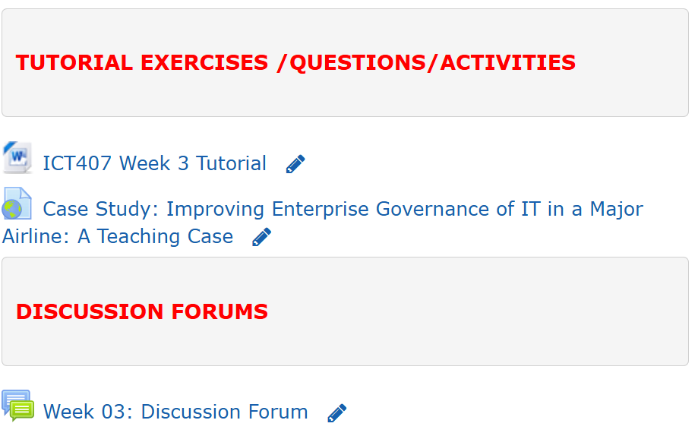
Tutorial Week 3

Slide 54
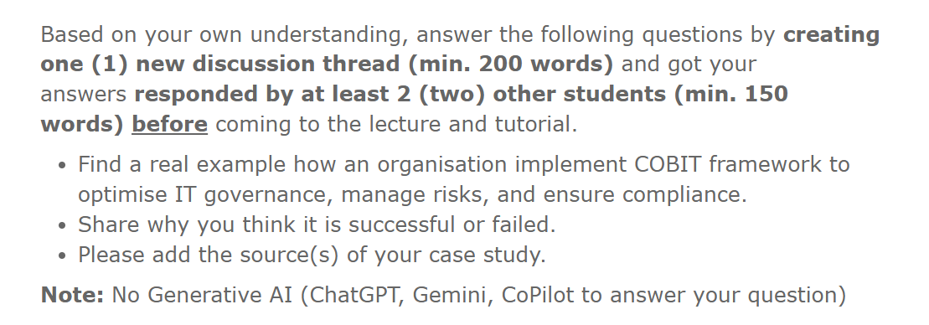
Tutorial Week 3

Slide 55
Tutorial Week 3
Tutorial Activities:
Case Study Discussion:
Activity: Read the case study "Improving Enterprise Governance of IT in a Major Airline: A Teaching Case."
Task: Work in a small group to discuss how KLM embarked on the journey towards improved enterprise governance of IT. If you were a business consultant, what approach would you take to launch such an improvement program?
Answer Requirement: Write your answers in detail in the provided text field (minimum 300 words).
Time allocated: 25 minutes
Note: Ensure you create a discussion thread and get your answers responded to by at least two other students (minimum 150 words) before the lecture and tutorial. Also, please add the source(s) of your case study and refrain from using generative AI tools like ChatGPT, Gemini, or CoPilot to answer your questions.

Slide 56
Tutorial Week 3
2. Identification of Structures, Processes, and Relational Mechanisms:
Activity: Revisit the case and identify the structures, processes, and relational mechanisms applied in this case.
Task: Clearly explain each of these practices and its role in the context of enterprise governance of IT.
Answer Requirement: Discuss in a small group and write your answers in detail in the provided text field (minimum 500 words).
Time allocated: 30 minutes
Note: Ensure you create a discussion thread and get your answers responded to by at least two other students (minimum 150 words) before the lecture and tutorial. Also, please add the source(s) of your case study and refrain from using generative AI tools like ChatGPT, Gemini, or CoPilot to answer your questions.

Slide 57
Tutorial Week 3
3. Staying on the Surfboard Principle:
Activity: Discuss the motivation and criteria behind the "staying on the surfboard principle."
Task: Explain how you think this framework could/should evolve over time.
Answer Requirement: Discuss in a small group and write your answers in detail in the provided text field (minimum 300 words).
Time allocated: 10 minutes
Note: Ensure you create a discussion thread and get your answers responded to by at least two other students (minimum 150 words) before the lecture and tutorial. Also, please add the source(s) of your case study and refrain from using generative AI tools like ChatGPT, Gemini, or CoPilot to answer your questions.

Slide 58
Tutorial Week 3
4. Portfolio Management Process:
Activity: The case describes the portfolio management process which begins with an identification of the business drivers.
Task: Explain why KLM developed a specific approach for capturing business drivers. What could be a point of critique in this process?
Answer Requirement: Discuss in a small group and write your answers in detail in the provided text field (minimum 300 words).
Time allocated: 10 minutes
Note: Ensure you create a discussion thread and get your answers responded to by at least two other students (minimum 150 words) before the lecture and tutorial. Also, please add the source(s) of your case study and refrain from using generative AI tools like ChatGPT, Gemini, or CoPilot to answer your questions.

Slide 59
Tutorial Week 3
5. Challenges Ahead for KLM:
Activity: The journey towards better enterprise governance of IT has been and continues to be an enriching one for KLM, and many challenges have been overcome.
Task: Identify important areas that need to be improved in the coming period to ensure the journey continues positively.
Answer Requirement: Discuss in a small group and write your answers in detail in the provided text field (minimum 300 words).
Time allocated: 15 minutes
Note: Ensure you create a discussion thread and get your answers responded to by at least two other students (minimum 150 words) before the lecture and tutorial. Also, please add the source(s) of your case study and refrain from using generative AI tools like ChatGPT, Gemini, or CoPilot to answer your questions.

Slide 60
Tutorial Week 3
6. Lessons Learned and Recommendations:
Activity: Reflect on the factors that have been key to KLM’s success and could be recommended to other organisations.
Task: Discuss the experiences and lessons learned by KLM that can benefit other organisations in improving their governance of IT.
Answer Requirement: Discuss in a small group and write your answers in detail in the provided text field (minimum 300 words).
Time allocated: 15 minutes
Note: Ensure you create a discussion thread and get your answers responded to by at least two other students (minimum 150 words) before the lecture and tutorial. Also, please add the source(s) of your case study and refrain from using generative AI tools like ChatGPT, Gemini, or CoPilot to answer your questions.

Slide 61
Tutorial Week 3
7. Wrap-Up:
Activity: Conclude the lecture and tutorial.
Task: Reflect on the learnings from Week 3.
Time allocated: 15 minutes
Note: Ensure you create a discussion thread and get your answers responded to by at least two other students (minimum 150 words) before the lecture and tutorial. Also, please add the source(s) of your case study and refrain from using generative AI tools like ChatGPT, Gemini, or CoPilot to answer your questions.

